Slide 1

Introduction to
Sequential Files

Slide 2
Files, Records, Fields.
We use the term FIELD to describe an item of information we are recording about an object
  (e.g. StudentName, DateOfBirth, CourseCode).
We use the term RECORD to describe the collection of fields which record information about an object
  (e.g. a StudentRecord is a collection of fields recording information about a student).
We use the term FILE to describe a collection of one or more occurrences (instances) of a record type (template).
It is important to distinguish between the record occurrence (i.e. the values of a record) and the record type (i.e. the structure of the record).
Every record in a file has a different value but the same structure.

Slide 3
Files, Records, Fields.
STUDENTS.DAT
StudId StudName DateOfBirth
9723456 DARSHINI 10091961
9724567 RAMA 31121976
9534118 KUMARA 23061964
9423458 DARSHAN 03111979
9312876 SMITHA 12121976
occurrences
DATA DIVISION.
FILE SECTION.
FD StudentFile.
01 StudentDetails.
02 StudId PIC 9(7).
02 StudName PIC X(8).
02 DateOfBirth PIC X(8).
Record Type
(Template)
(Structure)

Slide 4
Record Buffers
To process a file records are read from the file into the computer’s memory one record at a time.
The computer uses the programmers description of the record (i.e. the record template) to set aside sufficient memory to store one instance of the record.
Memory allocated for storing a record is usually called a “record buffer”
The record buffer is the only connection between the program and the records in the file.

Slide 5
Record Buffers
Program
IDENTIFICATION DIVISION.
etc.
ENVIRONMENT DIVISION.
etc.
DATA DIVISION.
FILE SECTION.
DISK
Record Instance
STUDENTS.DAT
RecordBuffer
Declaration

Slide 6
Implications of ‘Buffers’
If your program processes more than one file you will have to describe a record buffer for each file.
To process all the records in an INPUT file each record instance must be copied (read) from the file into the record buffer when required.
To create an OUTPUT file containing data records each record must be placed in the record buffer and then transferred (written) to the file.
To transfer a record from an input file to an output file we will have to
  read the record into the input record buffer
  transfer it to the output record buffer
  write the data to the output file from the output record buffer

Slide 7
Describing the record buffer in COBOL
DATA DIVISION.
FILE SECTION.
FD StudentFile.
01 StudentDetails.
02 StudentId PIC 9(7).
02 StudentName.
03 Surname PIC X(8).
03 Initials PIC XX.
02 DateOfBirth.
03 YOBirth PIC 9(2).
03 MOBirth PIC 9(2).
03 DOBirth PIC 9(2).
02 CourseCode PIC X(4).
02 Grant PIC 9(4).
02 Gender PIC X.
The record type/template/buffer of every file used in a program must be described in the FILE SECTION by means of an FD (file description) entry.
The FD entry consists of the letters FD and an internal file name.

Slide 8
The Select and Assign Clause.
ENVIRONMENT DIVISION.
INPUT-OUTPUT SECTION.
FILE-CONTROL.
SELECT StudentFile
ASSIGN TO “STUDENTS.DAT”.
DATA DIVISION.
FILE SECTION.
FD StudentFile.
01 StudentDetails.
02 StudentId PIC 9(7).
02 StudentName.
03 Surname PIC X(8).
03 Initials PIC XX.
02 DateOfBirth.
03 YOBirth PIC 9(2).
03 MOBirth PIC 9(2).
03 DOBirth PIC 9(2).
02 CourseCode PIC X(4).
02 Grant PIC 9(4).
02 Gender PIC X.
DISK
STUDENTS.DAT
The internal file name used in the FD entry is connected to an external file (on disk or tape) by means of the Select and Assign clause.

Slide 9
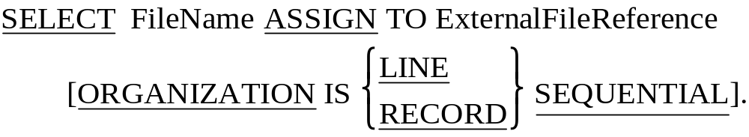
Select and Assign Syntax.
LINE SEQUENTIAL means each record is followed by the carriage return and line feed characters.
RECORD SEQUENTIAL means that the file consists of a stream of bytes. Only the fact that we know the size of each record allows us to retrieve them.

Slide 10
COBOL file handling Verbs
OPEN
Before your program can access the data in an input file or place data in an output file you must make the file available to the program by OPENing it.
READ
The READ copies a record occurrence/instance from the file and places it in the record buffer.
WRITE
The WRITE copies the record it finds in the record buffer to the file.
CLOSE
You must ensure that (before terminating) your program closes all the files it has opened. Failure to do so may result in data not being written to the file or users being prevented from accessing the file.

Slide 11

OPEN and CLOSE verb syntax
When you open a file you have to indicate to the system what how you want to use it (e.g. INPUT, OUTPUT, EXTEND) so that the system can manage the file correctly.
Opening a file does not transfer any data to the record buffer, it simply provides access.

Slide 12
The READ verb
Once the system has opened a file and made it available to the program it is the programmers responsibility to process it correctly.
Remember, the file record buffer is our only connection with the file and it is only able to store a single record at a time.
To process all the records in the file we have to transfer them, one record at a time, from the file to the buffer.
COBOL provides the READ verb for this purpose.

Slide 13
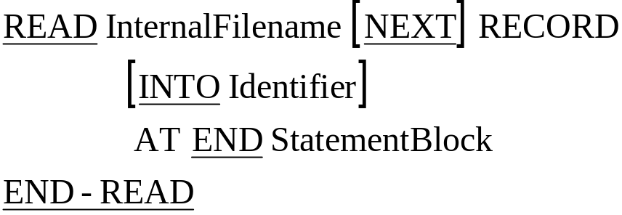
READ verb syntax
The InternalFilename specified must be a file that has been OPENed for INPUT.
The NEXT RECORD clause is optional and generally not used.
Using INTO Identifier clause causes the data to be read into the record buffer and then copied from there to the specified Identifier in one operation.
  When this option is used there will be two copies of the data. It is the equivalent of a READ followed by a MOVE.

Slide 14
How the READ works
StudentRecord
StudentID
StudentName
Course.
9
3
3
4
5
6
7
F
r
a
n
k
C
u
r
t
a
i
n
L
M
0
5
1
9
3
3
4
5
6
7
F
r
a
n
k
C
u
r
t
a
i
n
L
M
0
5
1
9
3
8
3
7
1
5
T
h
o
m
a
s
H
e
a
l
y
L
M
0
6
8
9
3
4
7
2
9
2
T
o
n
y
O
‘
B
r
i
a
n
L
M
0
5
1
9
3
7
8
8
1
1
B
i
l
l
y
D
o
w
n
e
s
L
M
0
2
1
EOF
PERFORM UNTIL StudentRecord = HIGH-VALUES
READ StudentRecords
AT END MOVE HIGH-VALUES TO StudentRecord
END-READ
END-PERFORM.

Slide 15
How the READ works
StudentRecord
StudentID
StudentName
Course.
9
3
8
3
7
1
5
T
h
o
m
a
s
H
e
a
l
y
L
M
0
6
8
9
3
3
4
5
6
7
F
r
a
n
k
C
u
r
t
a
i
n
L
M
0
5
1
9
3
8
3
7
1
5
T
h
o
m
a
s
H
e
a
l
y
L
M
0
6
8
9
3
4
7
2
9
2
T
o
n
y
O
‘
B
r
i
a
n
L
M
0
5
1
9
3
7
8
8
1
1
B
i
l
l
y
D
o
w
n
e
s
L
M
0
2
1
EOF
PERFORM UNTIL StudentRecord = HIGH-VALUES
READ StudentRecords
AT END MOVE HIGH-VALUES TO StudentRecord
END-READ
END-PERFORM.

Slide 16
How the READ works
StudentRecord
StudentID
StudentName
Course.
9
3
4
7
2
9
2
T
o
n
y
O
‘
B
r
i
a
n
L
M
0
5
1
9
3
3
4
5
6
7
F
r
a
n
k
C
u
r
t
a
i
n
L
M
0
5
1
9
3
8
3
7
1
5
T
h
o
m
a
s
H
e
a
l
y
L
M
0
6
8
9
3
4
7
2
9
2
T
o
n
y
O
‘
B
r
i
a
n
L
M
0
5
1
9
3
7
8
8
1
1
B
i
l
l
y
D
o
w
n
e
s
L
M
0
2
1
EOF
PERFORM UNTIL StudentRecord = HIGH-VALUES
READ StudentRecords
AT END MOVE HIGH-VALUES TO StudentRecord
END-READ
END-PERFORM.

Slide 17
How the READ works
StudentRecord
StudentID
StudentName
Course.
9
3
7
8
8
1
1
B
i
l
l
y
D
o
w
n
e
s
L
M
0
2
1
9
3
3
4
5
6
7
F
r
a
n
k
C
u
r
t
a
i
n
L
M
0
5
1
9
3
8
3
7
1
5
T
h
o
m
a
s
H
e
a
l
y
L
M
0
6
8
9
3
4
7
2
9
2
T
o
n
y
O
‘
B
r
i
a
n
L
M
0
5
1
9
3
7
8
8
1
1
B
i
l
l
y
D
o
w
n
e
s
L
M
0
2
1
EOF
PERFORM UNTIL StudentRecord = HIGH-VALUES
READ StudentRecords
AT END MOVE HIGH-VALUES TO StudentRecord
END-READ
END-PERFORM.

Slide 18
How the READ works
StudentRecord
StudentID
StudentName
Course.
☺
☺
☺
☺
☺
☺
☺
☺
☺
☺
☺
☺
☺
☺
☺
☺
☺
☺
☺
☺
☺
☺
☺
☺
☺
☺
☺
HIGH-VALUES
9
3
3
4
5
6
7
F
r
a
n
k
C
u
r
t
a
i
n
L
M
0
5
1
9
3
8
3
7
1
5
T
h
o
m
a
s
H
e
a
l
y
L
M
0
6
8
9
3
4
7
2
9
2
T
o
n
y
O
‘
B
r
i
a
n
L
M
0
5
1
9
3
7
8
8
1
1
B
i
l
l
y
D
o
w
n
e
s
L
M
0
2
1
EOF
PERFORM UNTIL StudentRecord = HIGH-VALUES
READ StudentRecords
AT END MOVE HIGH-VALUES TO StudentRecord
END-READ
END-PERFORM.

Slide 19
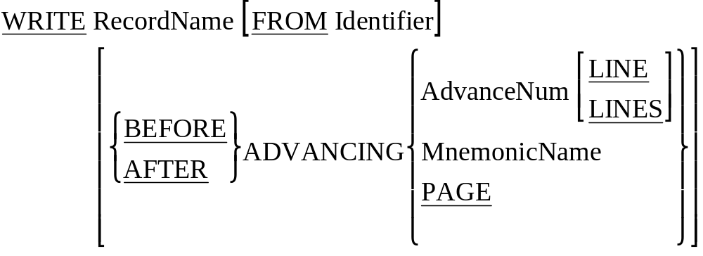
WRITE Syntax.
To WRITE data to a file move the data to the record buffer (declared in the FD entry) and then WRITE the contents of record buffer to the file.

Slide 20
How the WRITE works
OPEN OUTPUT StudentFile.
MOVE "9334567Frank Curtain LM051" TO StudentDetails.
WRITE StudentDetails.
MOVE "9383715Thomas Healy LM068" TO StudentDetails.
WRITE StudentDetails.
CLOSE StudentFile.
STOP RUN.
StudentRecord
StudentID
StudentName
Course.
9
3
3
4
5
6
7
F
r
a
n
k
C
u
r
t
a
i
n
L
M
0
5
1
Students.Dat
9
3
3
4
5
6
7
F
r
a
n
k
C
u
r
t
a
i
n
L
M
0
5
1
EOF

Slide 21
How the WRITE works
OPEN OUTPUT StudentFile.
MOVE "9334567Frank Curtain LM051" TO StudentDetails.
WRITE StudentDetails.
MOVE "9383715Thomas Healy LM068" TO StudentDetails.
WRITE StudentDetails.
CLOSE StudentFile.
STOP RUN.
StudentRecord
StudentID
StudentName
Course.
9
3
8
3
7
1
5
T
h
o
m
a
s
H
e
a
l
y
L
M
0
6
8
Students.Dat
9
3
3
4
5
6
7
F
r
a
n
k
C
u
r
t
a
i
n
L
M
0
5
1
9
3
8
3
7
1
5
T
h
o
m
a
s
H
e
a
l
y
L
M
0
6
8
EOF

Slide 22
$ SET SOURCEFORMAT"FREE"
IDENTIFICATION DIVISION.
PROGRAM-ID. SeqWrite.
AUTHOR. Michael Coughlan.
ENVIRONMENT DIVISION.
INPUT-OUTPUT SECTION.
FILE-CONTROL.
SELECT StudentFile ASSIGN TO "STUDENTS.DAT"
ORGANIZATION IS LINE SEQUENTIAL.
DATA DIVISION.
FILE SECTION.
FD StudentFile.
01 StudentDetails.
02 StudentId PIC 9(7).
02 StudentName.
03 Surname PIC X(8).
03 Initials PIC XX.
02 DateOfBirth.
03 YOBirth PIC 9(2).
03 MOBirth PIC 9(2).
03 DOBirth PIC 9(2).
02 CourseCode PIC X(4).
02 Grant PIC 9(4).
02 Gender PIC X.
PROCEDURE DIVISION.
Begin.
OPEN OUTPUT StudentFile.
DISPLAY "Enter student details using template below. Enter no data to end.".
PERFORM GetStudentDetails.
PERFORM UNTIL StudentDetails = SPACES
WRITE StudentDetails
PERFORM GetStudentDetails
END-PERFORM.
CLOSE StudentFile.
STOP RUN.
GetStudentDetails.
DISPLAY "NNNNNNNSSSSSSSSIIYYMMDDCCCCGGGGS".
ACCEPT StudentDetails.

Slide 23
$ SET SOURCEFORMAT"FREE"
IDENTIFICATION DIVISION.
PROGRAM-ID. SeqRead.
AUTHOR. Michael Coughlan.
ENVIRONMENT DIVISION.
INPUT-OUTPUT SECTION.
FILE-CONTROL.
SELECT StudentFile ASSIGN TO “STUDENTS.DAT”
ORGANIZATION IS LINE SEQUENTIAL.
DATA DIVISION.
FILE SECTION.
FD StudentFile.
01 StudentDetails.
02 StudentId PIC 9(7).
02 StudentName.
03 Surname PIC X(8).
03 Initials PIC XX.
02 DateOfBirth.
03 YOBirth PIC 9(2).
03 MOBirth PIC 9(2).
03 DOBirth PIC 9(2).
02 CourseCode PIC X(4).
02 Grant PIC 9(4).
02 Gender PIC X.
PROCEDURE DIVISION.
Begin.
OPEN INPUT StudentFile
READ StudentFile
AT END MOVE HIGH-VALUES TO StudentDetails
END-READ
PERFORM UNTIL StudentDetails = HIGH-VALUES
DISPLAY StudentId SPACE StudentName SPACE CourseCode
READ StudentFile
AT END MOVE HIGH-VALUES TO StudentDetails
END-READ
END-PERFORM
CLOSE StudentFile
STOP RUN.

Slide 24
Relative
Files.

Slide 25
Creating a Relative File
$ SET SOURCEFORMAT"FREE"
IDENTIFICATION DIVISION.
PROGRAM-ID. CreateRelativeFromSeq.
* Creates a Relative file from a sequential file.
ENVIRONMENT DIVISION.
INPUT-OUTPUT SECTION.
FILE-CONTROL.
SELECT SupplierFile ASSIGN TO "SUPP.DAT"
ORGANIZATION IS RELATIVE
ACCESS MODE IS RANDOM
RELATIVE KEY IS SupplierKey
FILE STATUS IS SupplierStatus.
SELECT SupplierFileSeq ASSIGN TO "INSUPP.DAT".
DATA DIVISION.
FILE SECTION.
FD SupplierFile.
01 SupplierRecord.
02 SupplierCode PIC 99.
02 SupplierName PIC X(20).
02 SupplierAddress PIC X(60).
FD SupplierFileSeq.
01 SupplierRecordSeq.
88 EndOfFile VALUE HIGH-VALUES.
02 SupplierCodeSeq PIC 99.
02 SupplierNameSeq PIC X(20).
02 SupplierAddressSeq PIC X(60).
WORKING-STORAGE SECTION.
01 SupplierStatus PIC X(2).
01 SupplierKey PIC 99.

Slide 26
Creating a Relative File
$ SET SOURCEFORMAT"FREE"
IDENTIFICATION DIVISION.
PROGRAM-ID. CreateRelativeFromSeq.
* Creates a Relative file from a sequential file.
ENVIRONMENT DIVISION.
INPUT-OUTPUT SECTION.
FILE-CONTROL.
SELECT SupplierFile ASSIGN TO "SUPP.DAT"
ORGANIZATION IS RELATIVE
ACCESS MODE IS RANDOM
RELATIVE KEY IS SupplierKey
FILE STATUS IS SupplierStatus.
SELECT SupplierFileSeq ASSIGN TO "INSUPP.DAT".
DATA DIVISION.
FILE SECTION.
FD SupplierFile.
01 SupplierRecord.
02 SupplierCode PIC 99.
02 SupplierName PIC X(20).
02 SupplierAddress PIC X(60).
FD SupplierFileSeq.
01 SupplierRecordSeq.
88 EndOfFile VALUE HIGH-VALUES.
02 SupplierCodeSeq PIC 99.
02 SupplierNameSeq PIC X(20).
02 SupplierAddressSeq PIC X(60).
WORKING-STORAGE SECTION.
01 SupplierStatus PIC X(2).
01 SupplierKey PIC 99.

Slide 27
Creating a Relative File
PROCEDURE DIVISION.
Begin.
OPEN OUTPUT SupplierFile.
OPEN INPUT SupplierFileSeq.
READ SupplierFileSeq
AT END SET EndOfFile TO TRUE
END-READ
PERFORM UNTIL EndOfFile
MOVE SupplierCodeSeq TO SupplierKey
MOVE SupplierRecordSeq TO SupplierRecord
WRITE SupplierRecord
INVALID KEY DISPLAY "SUPP STATUS :-", SupplierStatus
END-WRITE
READ SupplierFileSeq
AT END SET EndOfFile TO TRUE
END-READ
END-PERFORM.
CLOSE SupplierFile, SupplierFileSeq.
STOP RUN.

Slide 28
Reading a Relative File.
$ SET SOURCEFORMAT"FREE"
IDENTIFICATION DIVISION.
PROGRAM-ID. ReadRelative.
* Reads a Relative file directly or in sequence
ENVIRONMENT DIVISION.
INPUT-OUTPUT SECTION.
FILE-CONTROL.
SELECT SupplierFile ASSIGN TO "SUPP.DAT"
ORGANIZATION IS RELATIVE
ACCESS MODE IS DYNAMIC
RELATIVE KEY IS SupplierKey
FILE STATUS IS SupplierStatus.
DATA DIVISION.
FILE SECTION.
FD SupplierFile.
01 SupplierRecord.
88 EndOfFile VALUE HIGH-VALUES.
02 SupplierCode PIC 99.
02 SupplierName PIC X(20).
02 SupplierAddress PIC X(60).
WORKING-STORAGE SECTION.
01 SupplierStatus PIC X(2).
88 RecordFound VALUE "00".
01 SupplierKey PIC 99.
01 PrnSupplierRecord.
02 PrnSupplierCode PIC BB99.
02 PrnSupplierName PIC BBX(20).
02 PrnSupplierAddress PIC BBX(50).
01 ReadType PIC 9.
88 DirectRead VALUE 1.
88 SequentialRead VALUE 2.

Slide 29
Reading a Relative File.
PROCEDURE DIVISION.
BEGIN.
OPEN INPUT SupplierFile.
DISPLAY "Enter Read type (Direct=1, Seq=2)-> " WITH NO ADVANCING.
ACCEPT ReadType.
IF DirectRead
DISPLAY "Enter supplier key (2 digits)-> " WITH NO ADVANCING
ACCEPT SupplierKey
READ SupplierFile
INVALID KEY DISPLAY "SUPP STATUS :-", SupplierStatus
END-READ
PERFORM DisplayRecord
END-IF
IF SequentialRead
READ SupplierFile NEXT RECORD
AT END SET EndOfFile TO TRUE
END-READ
PERFORM UNTIL EndOfFile
PERFORM DisplayRecord
READ SupplierFile NEXT RECORD
AT END SET EndOfFile TO TRUE
END-READ
END-PERFORM
END-IF
CLOSE SupplierFile.
STOP RUN.
DisplayRecord.
IF RecordFound
MOVE SupplierCode TO PrnSupplierCode
MOVE SupplierName TO PrnSupplierName
MOVE SupplierAddress TO PrnSupplierAddress
DISPLAY PrnSupplierRecord
END-IF.

Slide 30
Reading a Relative File.
RUN OF REL-EG2.EXE USING SEQUENTIAL READING
Enter Read type (Direct=1, Seq=2)-> 2
01 VESTRON VIDEOS OVER THE SEA SOMEWHERE IN LONDON
02 EMI STUDIOS HOLLYWOOD, CALIFORNIA, USA
03 BBC WILDLIFE BUSH HOUSE, LONDON, ENGLAND
04 CBS STUDIOS HOLLYWOOD, CALIFORNIA, USA
05 YACHTING MONTHLY TREE HOUSE, LONDON, ENGLAND
06 VIRGIN VIDEOS IS THIS ONE ALSO LOCATED IN ENGLAND
07 CIC VIDEOS NEW YORK PLAZZA, NEW YORK, USA
RUN OF REL-EG2.EXE USING DIRECT READ
Enter Read type (Direct=1, Seq=2)-> 1
Enter supplier key (2 digits)-> 05
05 YACHTING MONTHLY TREE HOUSE, LONDON, ENGLAND

Slide 31
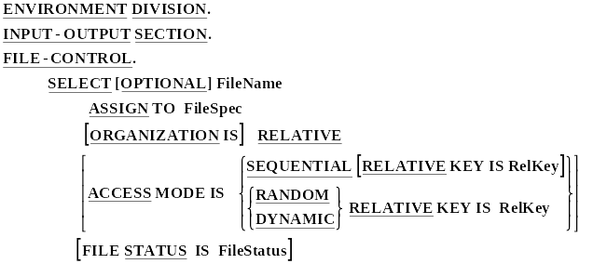
Select and Assign for Relative Files

Slide 32
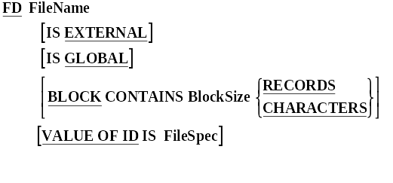
FDs for Relative Files

Slide 33
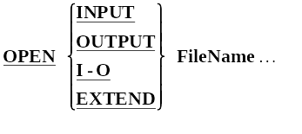
Relative File Verbs - OPEN

Slide 34
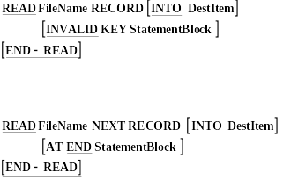
Relative File Verbs - READ

Slide 35


Relative File Verbs - Write and Rewrite

Slide 36
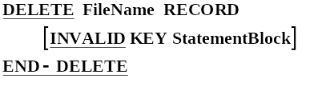
Relative File Verbs - DELETE

Slide 37
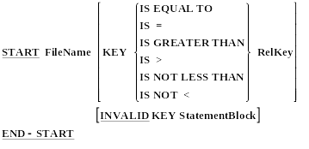
Relative File Verbs - START

Slide 38
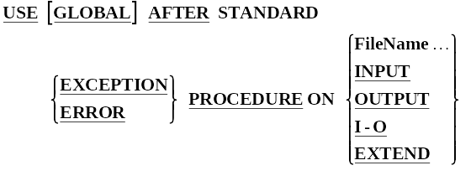
Error Handling Using Declaratives.
PROCEDURE DIVISION.
DECLARATIVES.
SectionOne SECTION.
USE clause for this section.
ParOne1.
????????????????
????????????????
ParOne2.
????????????????
????????????????
SectionTwo SECTION.
USE clause for this section.
ParTwo1.
????????????????
????????????????
ParTwo2.
????????????????
????????????????
END-DECLARATIVES.
Main SECTION.
Begin.

Slide 39
Error Handling Using Declaratives.
PROCEDURE DIVISION.
DECLARATIVES.
FileError SECTION.
USE AFTER ERROR PROCEDURE ON RelativeFile.
CheckFileStatus.
EVALUATE TRUE
WHEN RecordDoesNotExist
DISPLAY "Record does not exist"
WHEN RecordAlreadyExists
DISPLAY "Record already exists"
WHEN FileNotOpen OPEN I-O RelativeFile
END-EVALUATE.
END-DECLARATIVES.
Main SECTION.
Begin.

